Slide 1

Software Engineering Industry in Asia: Trends and Challenges
Matthew Dailey
Asian Institute of Technology

Slide 2
Introduction
Software engineering is changing rapidly.
  Software development and business analysis are converging.
  Software architecture complexity is increasing.
The Asian software industry needs to move up the value chain.
  Offshore development for Western companies will not sustain growth.
  Asian software companies need to cultivate innovation.
To be successful in this environment, software engineers:
  Need deep knowledge of technology, especially architecture.
  Need broad knowledge of project management, development, test, and quality control processes.

Slide 3
Software Architecture Trends
Within the enterprise, the goal of IT is to automate crucial business processes.
Organizations need fast turnaround time on software change requests.
But the typical IT infrastructure is too complex to make rapid changes easily.
  It is difficult to estimate effort required, leading to cost overruns.
  It is difficult to understand the effects of a change, leading to unanticipated software flaws.

Slide 4
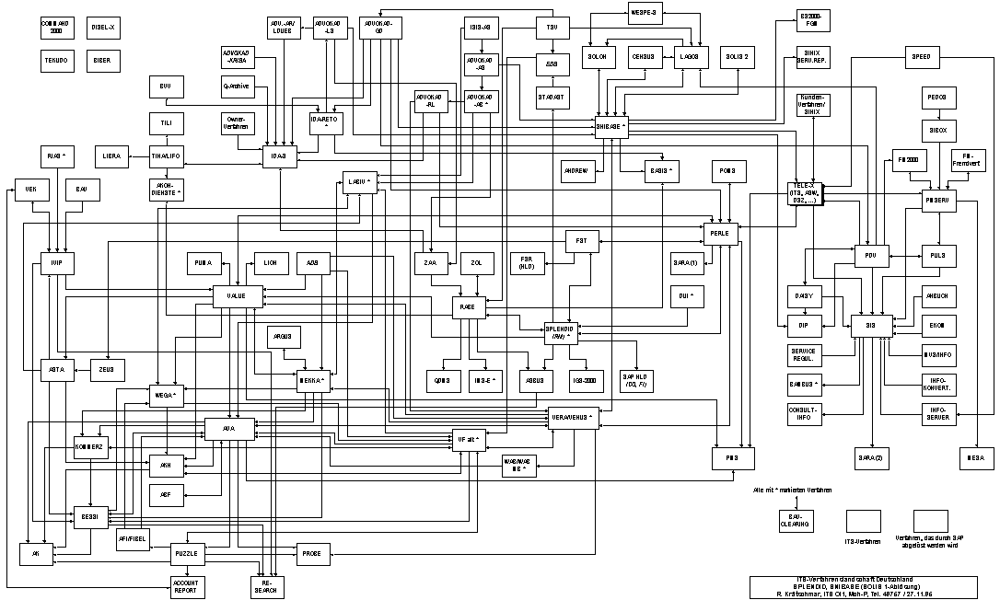
Example of enterprise application connectivity (Siemens, 2002)

Slide 5
Software Architecture Trends
Software architectures are evolving to help mitigate these complexities.
  Structured programming
  Object oriented design
  Remote method invocation
  Asynchronous message processing
  Enterprise application integration
  Service oriented architecture
  Cloud computing

Slide 6
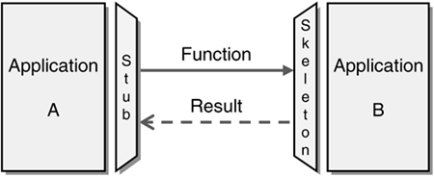
Remote Method Invocation
Hohpe and Woolf, 2004
Achieve reuse by deploying software components on the network.
Add middleware to transform local requests into remote requests.
Service provider and requester are too tightly coupled.

Slide 7
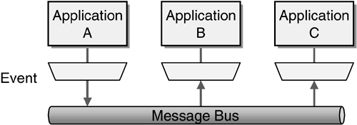
Asynchronous Messaging
Hohpe and Woolf, 2004
Decrease coupling of requester and provider by adding a messaging infrastructure and event-driven processing.
Requester and provider are still coupled by message format.
Communication is point-to-point, leading to too much interconnection.

Slide 8
Enterprise Application Integration
Reduce point-to-point communication links using a central integration broker.
Add message transformation to eliminate message format coupling.
Add central process manager to orchestrate distributed business processes.
The hub becomes a central point of failure.
Tools and protocols are proprietary.
EAI

Slide 9
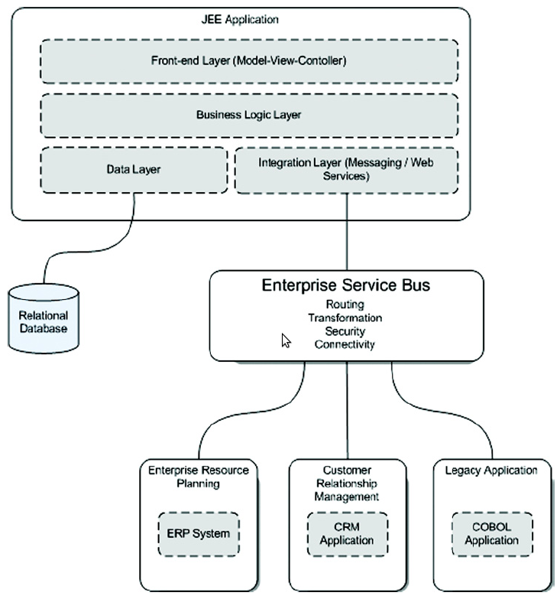
Service Oriented Architectures
Replace proprietary central hub with a distributed bus.
Replace proprietary protocols and vendor lock-in with open standards and translations.
Deployment, management, and monitoring of services becomes difficult.
Rademakers and Dirksen, 2009

Slide 10
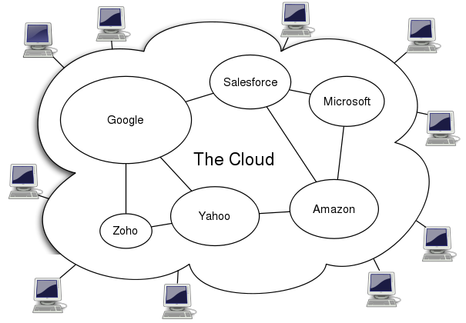
Cloud Computing
Wikipedia, 2009
Virtualize the infrastructure to make deployment, management, and monitoring easier.
Outsource services to third parties as much as possible.
Technology and standards are still evolving.

Slide 11
Software Architecture Trends: Summary
Today’s IT architectures must deploy and manage services that align with and automate business processes.
Application developers are doing less programming and more business analysis.
Architects need deep skills in technology and broad skills in team leadership, software processes, and business analysis.
Where does the Asian workforce currently stand?

Slide 12
Trends in Asia
Demand growth for software engineers is rapidly outpacing supply in Western countries.
Offshoring software development work to Asia has become a proven way for Western companies to reduce costs without sacrificing quality.
Costs are rising in India, and clients are looking elsewhere, especially to China and Vietnam.

Slide 13
Trends in Vietnam
The domestic IT industry is booming
With strong support from the government, the Vietnamese software industry is attracting significant offshore development work.
The workforce is large, young, fast learning, creative, and strongly interested in technology.
However, the Vietnamese university system is unable to meet the software industry's demand.
Hiring managers report that it is possible to find skilled Java and .NET developers but almost impossible to find architects with sufficiently deep skills in technology, analysis, design, and quality control.

Slide 14
Trends and Challenges for Asia
Top-tier Western companies (IBM, EDS, etc.) want to keep innovation in house and only offshore mundane tasks.
But low-level offshoring work will not sustain the growth of the Asian software industry indefinitely.
The industry needs to foster innovation in order to move up the software value chain.

Slide 15
Trends and Challenges for Asia: Summary
The software industry is rapidly evolving.
Modern software engineers need a mix of skills, from business analysis to software testing.
In Asia, the industry’s biggest need is software engineers with deep understanding of software architecture and broad skills in team leadership, software processes, and business analysis.
Software engineers that improve their skills in these areas will do very well in coming years.

